Slide 1
Cyclistic Rider Trips
Presented by: Kaheem Walters
Last Updated: October 29, 2022

Slide 2
Table of Contents
Purpose Statement
Data Story
Conclusion
Appendix

Slide 3
Objective
Identify how members and casual riders use Cyclistic bikes differently

Slide 4
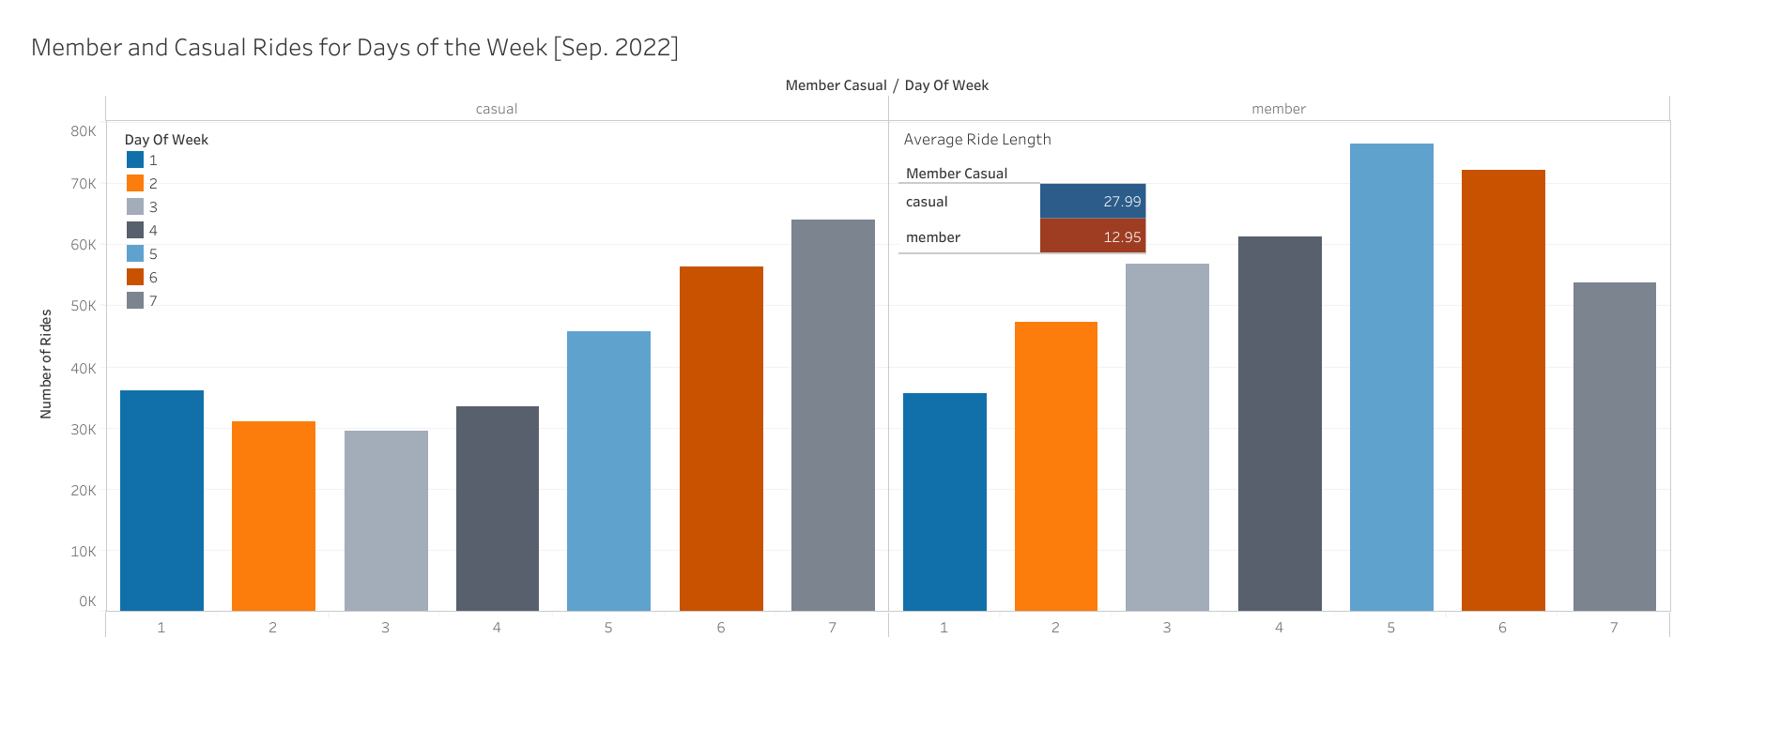
Last Month Trip Data
Key Takeaways:
In September 2022, casuals traveled more on Saturdays and members on Thursday.
Members had more trips but casuals on average had longer trips

Slide 5
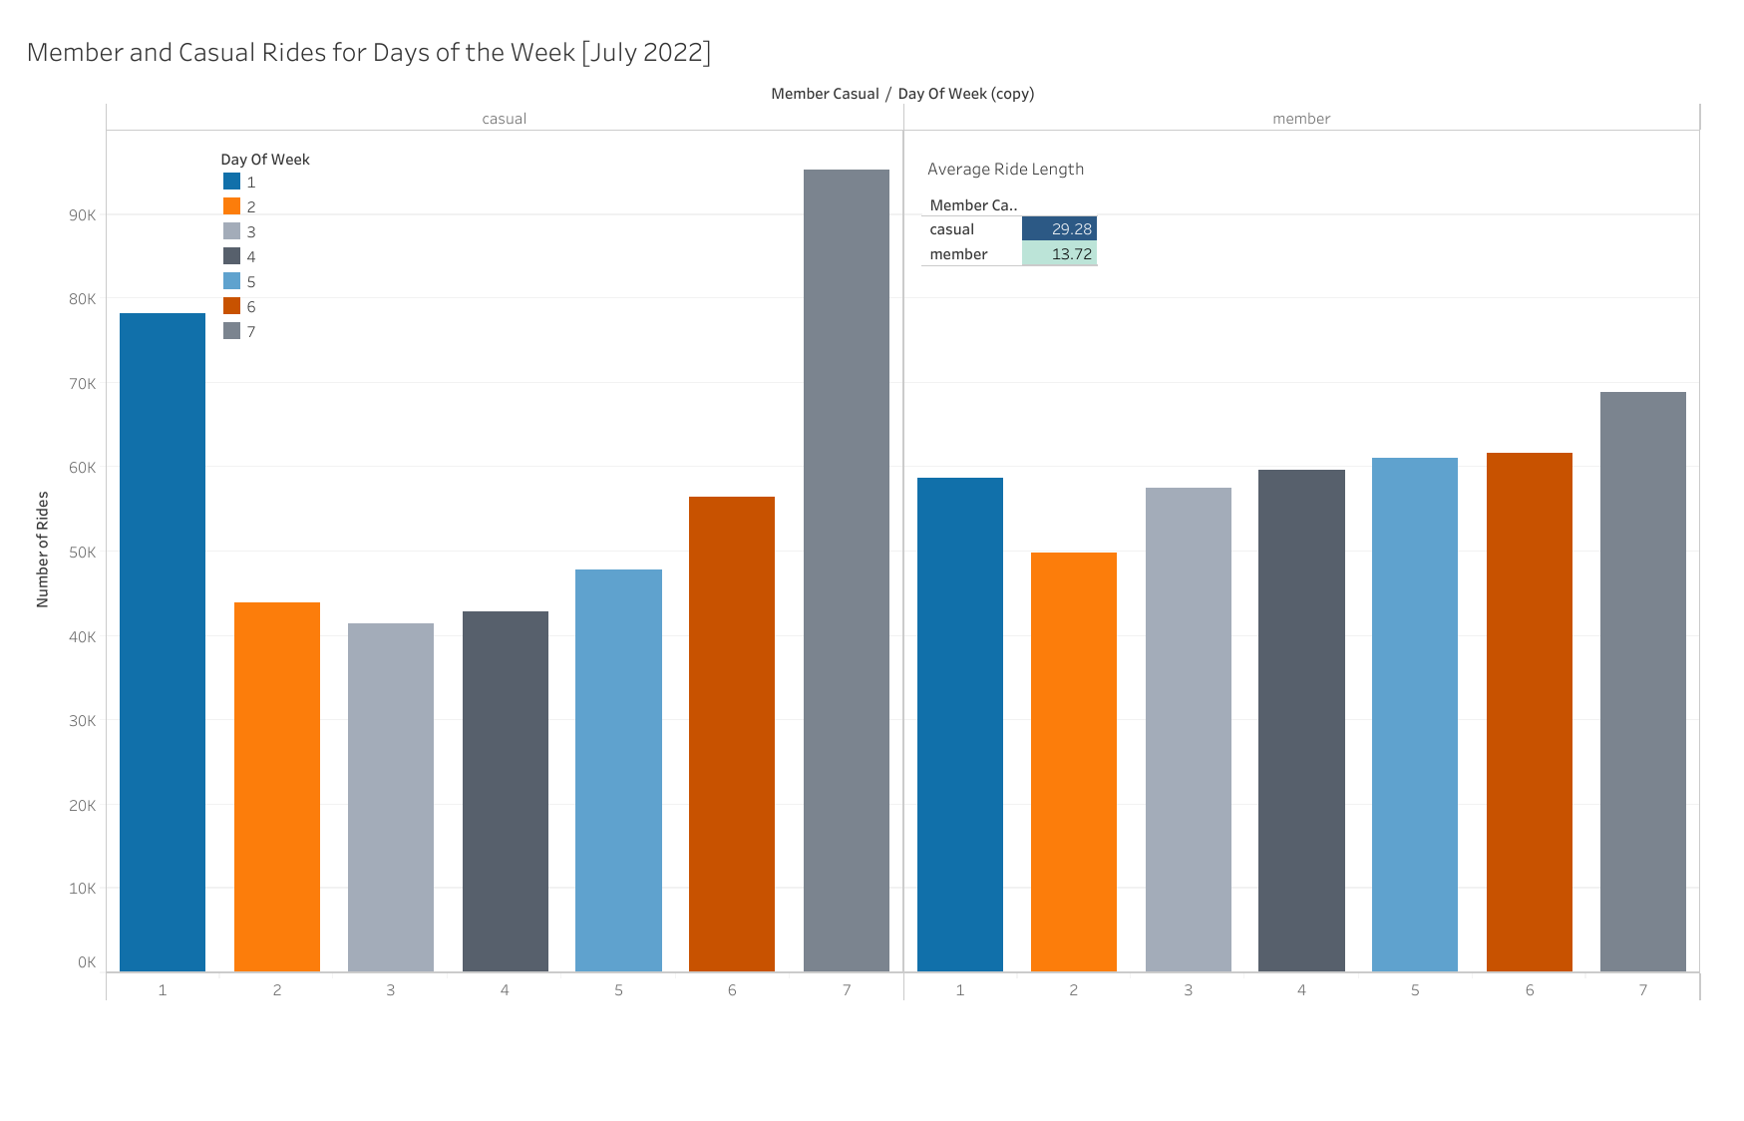
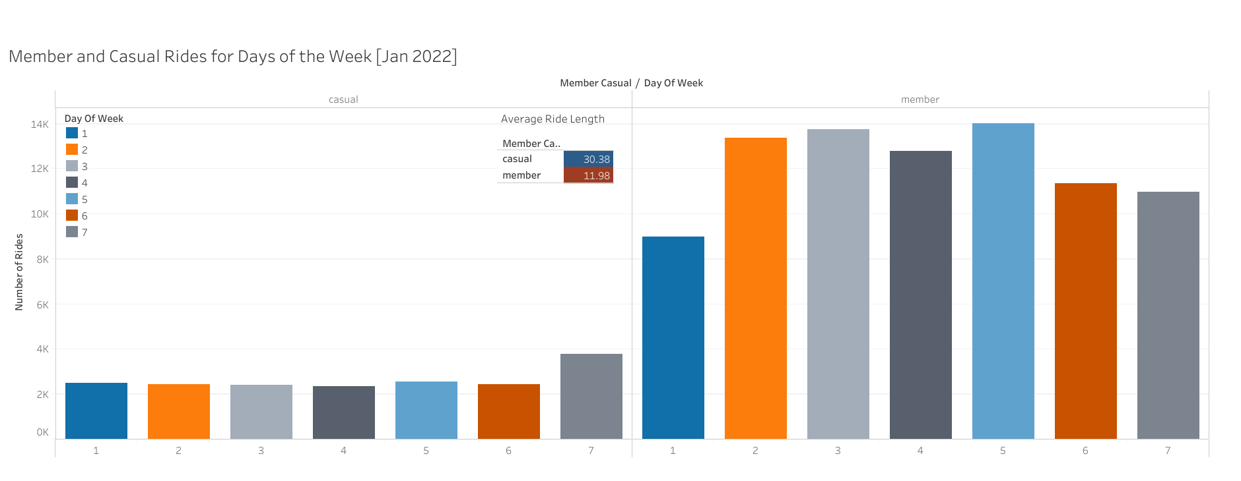
Bike Usage in the Past Year
Casual riders on average have longer trip durations than members
Weekends are usually busier than weekdays for casual but not members
Number of rides depend on the time of year, especially for casuals
Most used station by casual riders is Streeter Dr & Grand Ave
Most used station by members is Kingsbury St & Kinzie St
Notes:
The average bike trip duration for casual riders year-round are always double that of members. This may be due to casual customers taking advantage of the low price of the single ride pass to travel everywhere in the city and completing multiple tasks before checking back in the bikes. While members are likely checking in their bike to the nearest station multiple times a day. The weekend also seems to be favored by the casual riders versus the members who use the bikes consistently throughout the week (most likely for commuting). As for seasons, members stay pretty consistent as well, while casuals seem to not ride as often during the colder months around winter.

Slide 6
Conclusion

Slide 7
Conclusion
The number of casual rides depend heavily on the time of year.
On average, casuals rent out bikes for approximately double the amount of time as members.
Casual riders generally rent out bikes for the weekend while members are more likely to rent out consistently throughout the week.
Notes:
Assumptions: members incorporate bike usage to daily schedule and has consistent numbers, while the usage for casuals very dramatically between months and days of the weeks (due to events, tourism, etc.) Casuals rent out bikes for twice the time of members on average (probable cause is full day passes) while members rent out bikes more often. Further info needed to see if tourism plays a part.

Slide 8
Thank You

Slide 9
Appendix
The City of Chicago owns all right, title, and interest in the Data
Motivate International, I. (n.d.). Divvy System Data. Divvy Bikes. Retrieved October 28, 2022, from https://divvybikes.com/system-data

